Slide 1
Boolean Logic
Elements of Computing Systems, Nisan & Schocken, MIT Press www.idc.ac.il/tecs
Usage and Copyright Notice:
Copyright 2005 © Noam Nisan and Shimon Schocken
This presentation contains lecture materials that accompany the textbook “The Elements of Computing Systems” by Noam Nisan & Shimon Schocken, MIT Press, 2005.
We provide both PPT and PDF versions.
The book web site, www.idc.ac.il/tecs , features 13 such presentations, one for each book chapter. Each presentation is designed to support about 3 hours of classroom or self-study instruction.
You are welcome to use or edit this presentation as you see fit for instructional and non-commercial purposes.
If you use our materials, we will appreciate it if you will include in them a reference to the book’s web site.
If you have any questions or comments, you can reach us at tecs.ta@gmail.com

Slide 2

Boolean algebra
Some elementary Boolean operators:
Not(x)
And(x,y)
Or(x,y)
Nand(x,y)
x Not(x)
0 1
1 0
x y And(x,y)
0 0 0
0 1 0
1 0 0
1 1 1
x y Or(x,y)
0 0 0
0 1 1
1 0 1
1 1 1
x y Nand(x,y)
0 0 1
0 1 1
1 0 1
1 1 0
Boolean functions:
x y z
0 0 0 0
0 0 1 0
0 1 0 1
0 1 1 0
1 0 0 1
1 0 1 0
1 1 0 1
1 1 1 0
Functional expression VS
truth table expression
Important result: Every Boolean function can be expressed using And, Or, Not.

Slide 3
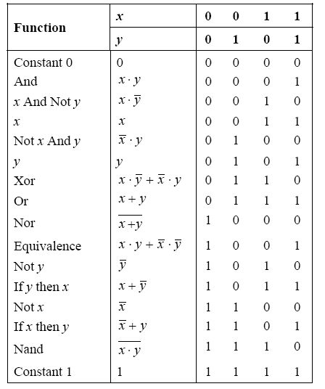
All Boolean functions of 2 variables

Slide 4
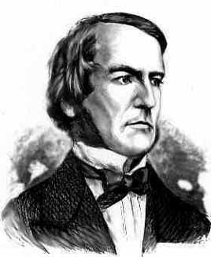
Boolean algebra
Given: Nand(a,b), false
We can build:
Not(a) = Nand(a,a)
true = Not(false)
And(a,b) = Not(Nand(a,b))
Or(a,b) = Not(And(Not(a),Not(b)))
Xor(a,b) = Or(And(a,Not(b)),And(Not(a),b)))
Etc.
George Boole, 1815-1864
(“A Calculus of Logic”)

Slide 5
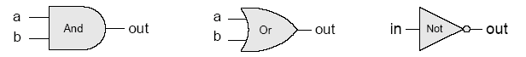
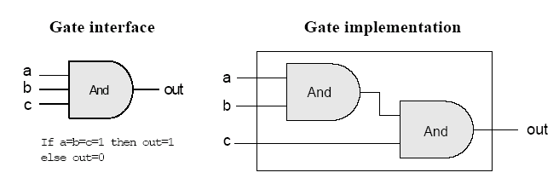
Gate logic
Gate logic – a gate architecture designed to implement a Boolean function
Elementary gates:
Composite gates:
Important distinction: Interface (what) VS implementation (how).

Slide 6

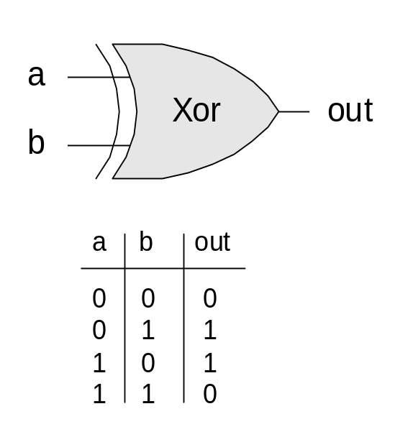
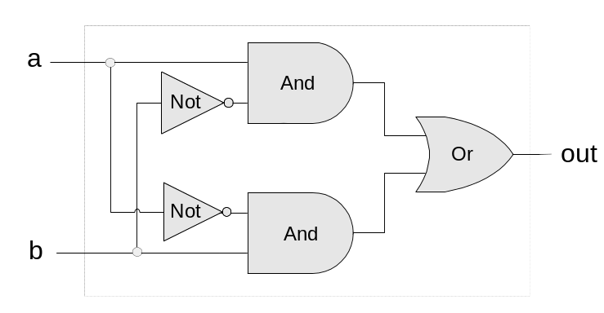
Gate logic
Interface
Claude Shannon, 1916-2001
(“Symbolic Analysis of Relay and Switching Circuits” )
Implementation
Xor(a,b) = Or(And(a,Not(b)),And(Not(a),b)))

Slide 7
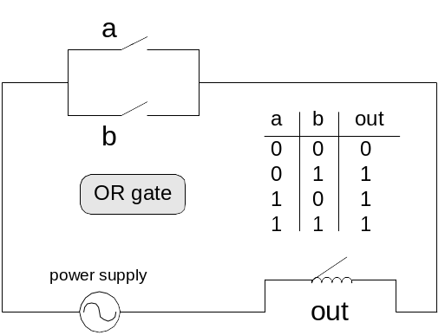
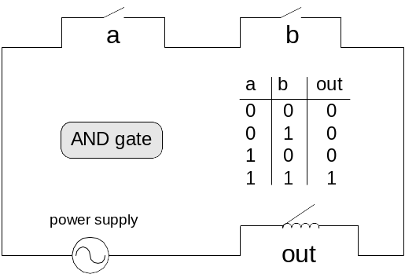
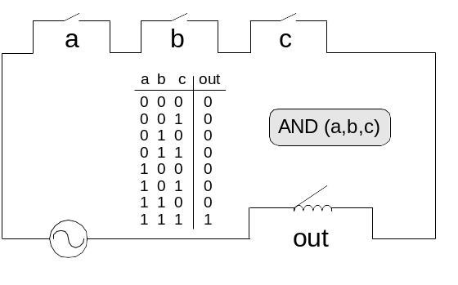
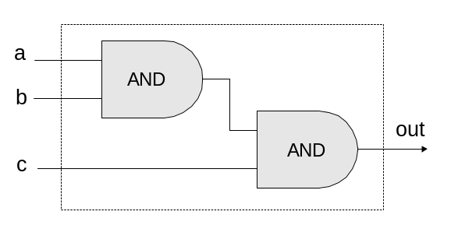
Circuit implementations
From a computer science perspective, physical realizations of logic gates are irrelevant.

Slide 8
Project 1: elementary logic gates
Given: Nand(a,b), false
a b Nand(a,b)
0 0 1
0 1 1
1 0 1
1 1 0
Build:
Not(a) = ...
true = ...
And(a,b) = ...
Or(a,b) = ...
Mux(a,b,sel) = ...
Etc. - 12 gates altogether.
Why these particular 12 gates? Since …
  They are commonly used gates
  They provide all the basic building blocks needed to build our computer.

Slide 9
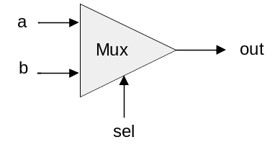
Multiplexer
a b sel out
0 0 0 0
0 0 1 0
0 1 0 0
0 1 1 1
1 0 0 1
1 0 1 0
1 1 0 1
1 1 1 1
sel out
0 a
1 b
Proposed Implementation: based on Not, And, Or gates.

Slide 10
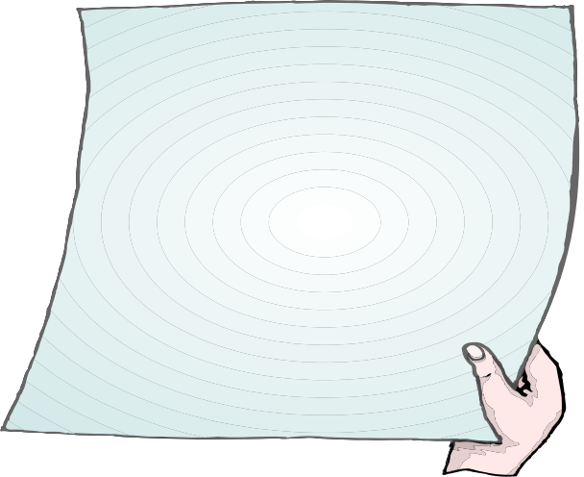
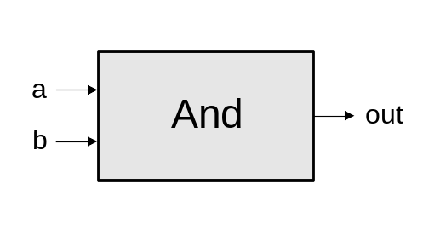
Example: Building an And gate
Contract:
When running your .hdl on our .tst, your .out should be the same as
our .cmp.
And.cmp
a b out
0 0 0
0 1 0
1 0 0
1 1 1
And.hdl
And.tst
CHIP And
{ IN a, b;
OUT out;
// implementation missing
}
load And.hdl,
output-file And.out,
compare-to And.cmp,
output-list a b out;
set a 0,set b 0,eval,output;
set a 0,set b 1,eval,output;
set a 1,set b 0,eval,output;
set a 1, set b 1, eval, output;

Slide 11

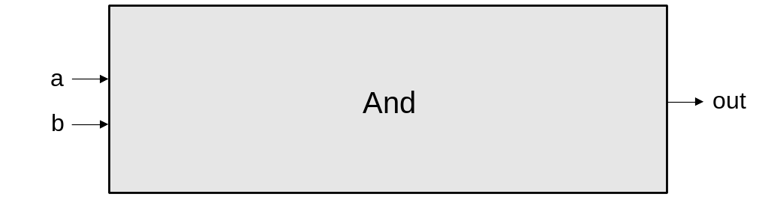
Building an And gate
Interface: And(a,b) = 1 exactly when a=b=1
And.hdl
CHIP And
{ IN a, b;
OUT out;
// implementation missing
}

Slide 12

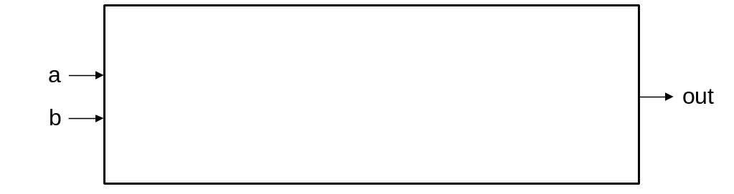
Building an And gate
Implementation: And(a,b) = Not(Nand(a,b))
And.hdl
CHIP And
{ IN a, b;
OUT out;
// implementation missing
}

Slide 13
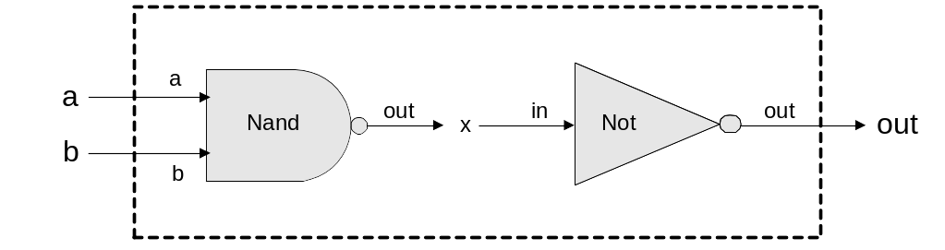
Building an And gate
Implementation: And(a,b) = Not(Nand(a,b))
And.hdl
CHIP And
{ IN a, b;
OUT out;
// implementation missing
}

Slide 14
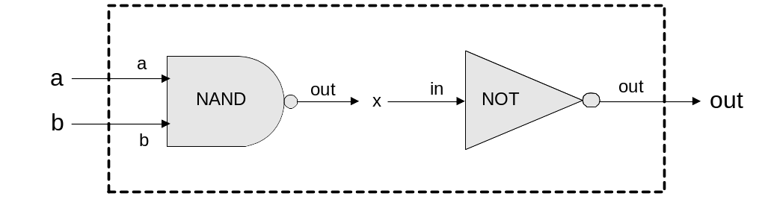
Building an And gate
Implementation: And(a,b) = Not(Nand(a,b))
And.hdl
CHIP And
{ IN a, b;
OUT out;
Nand(a = a,
b = b,
out = x);
Not(in = x, out = out)
}

Slide 15
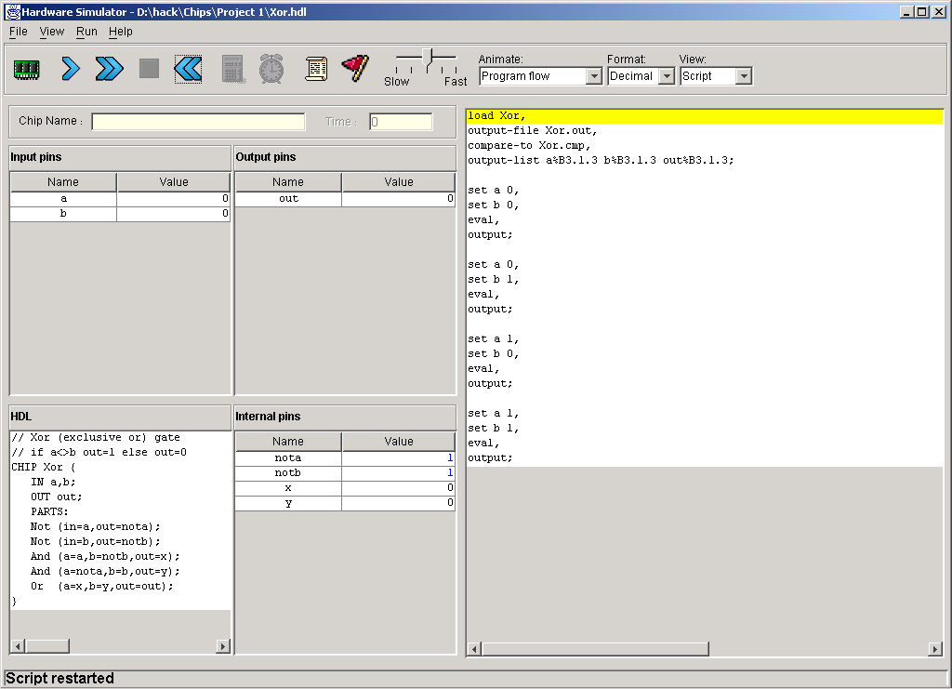
Hardware simulator (demonstrating Xor gate construction)
HDL program
test script

Slide 16
Hardware simulator
HDL program

Slide 17
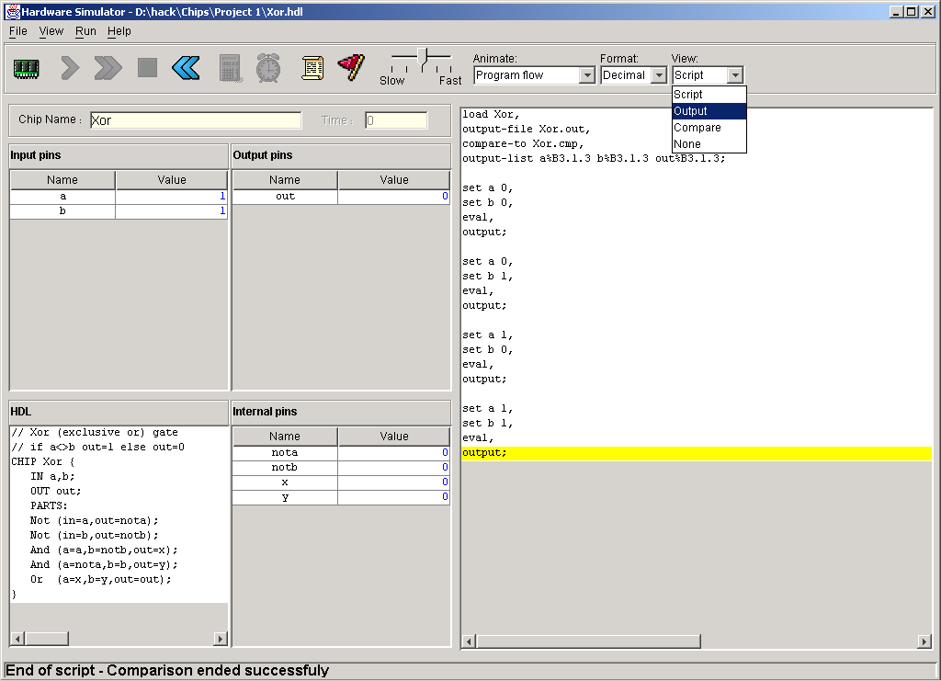
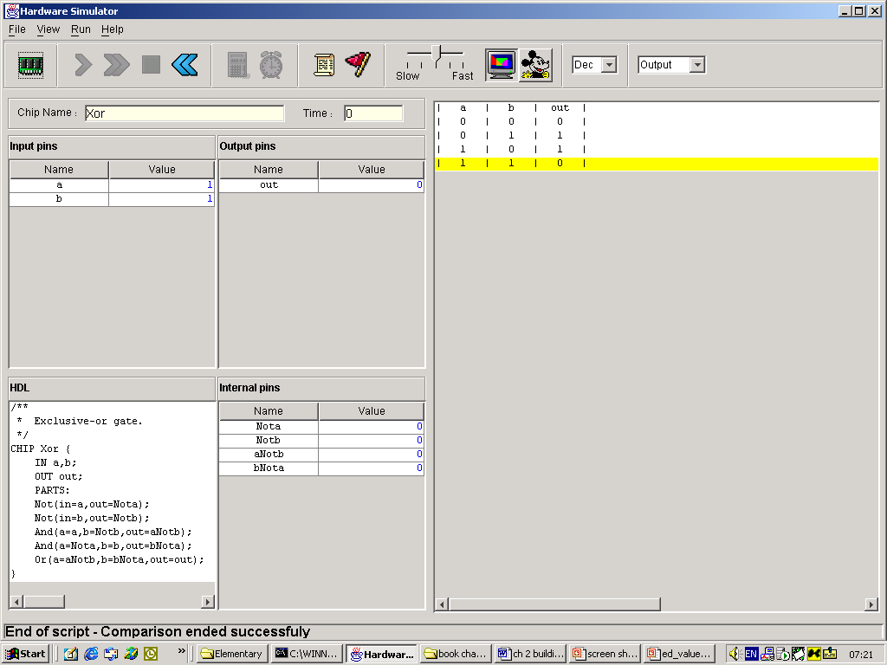
Hardware simulator
HDL program
output file

Slide 18
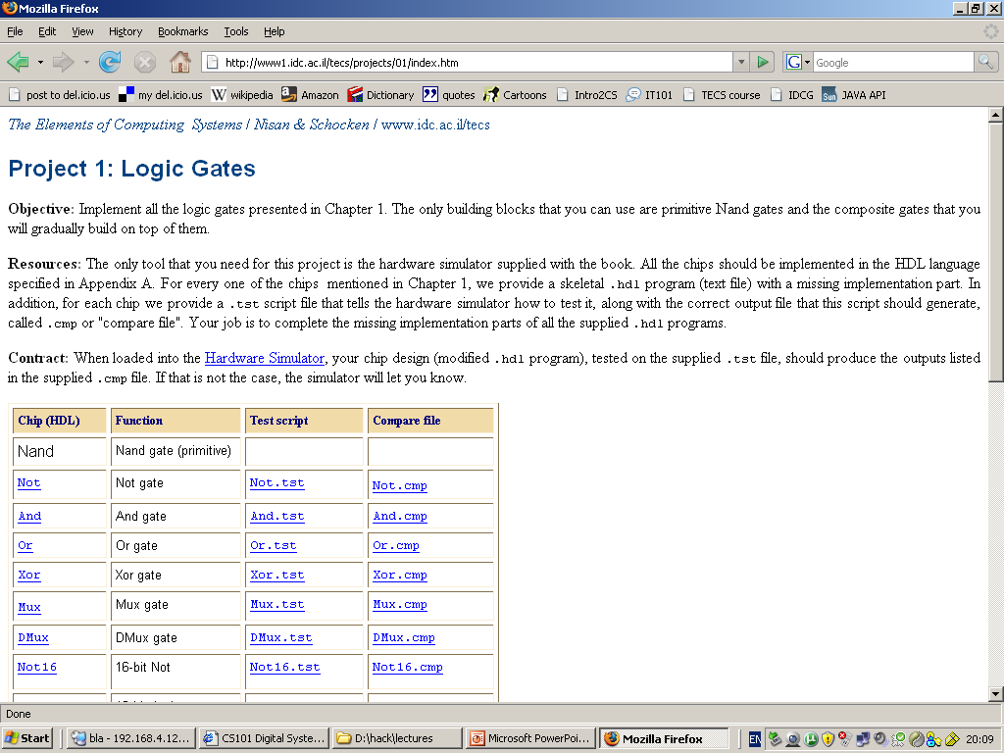
Project materials
Project 1 on the course web site
And.hdl , And.tst , And.cmp files

Slide 19
Project 1 tips
Read Chapter 1 of the book
Download the book’s software suite
Go through the hardware simulator tutorial
Do Project 0 (optional)
You’re in business.

Slide 20

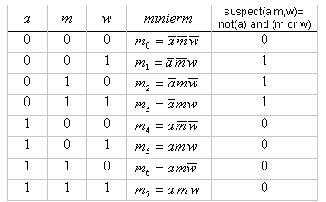
End notes: Canonical representation
Truth table of the function
Canonical form:

Slide 21
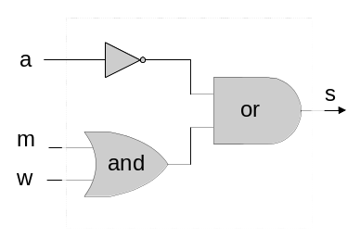
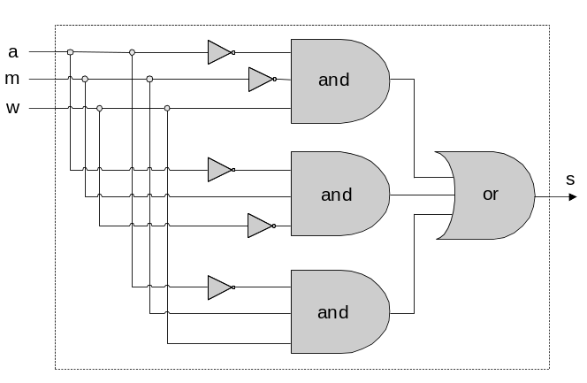
End notes: Canonical representation (cont.)

Slide 22
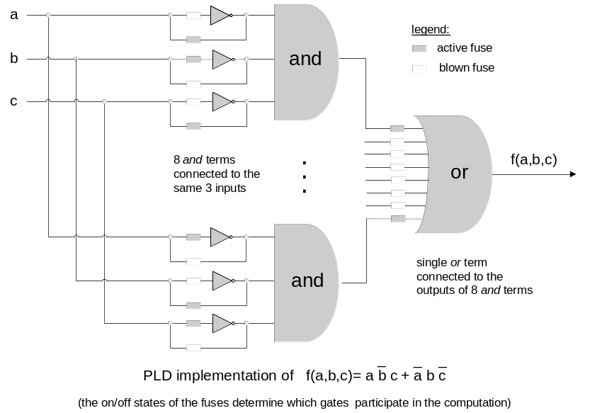
End notes: Programmable Logic Device for 3-way functions

Slide 23
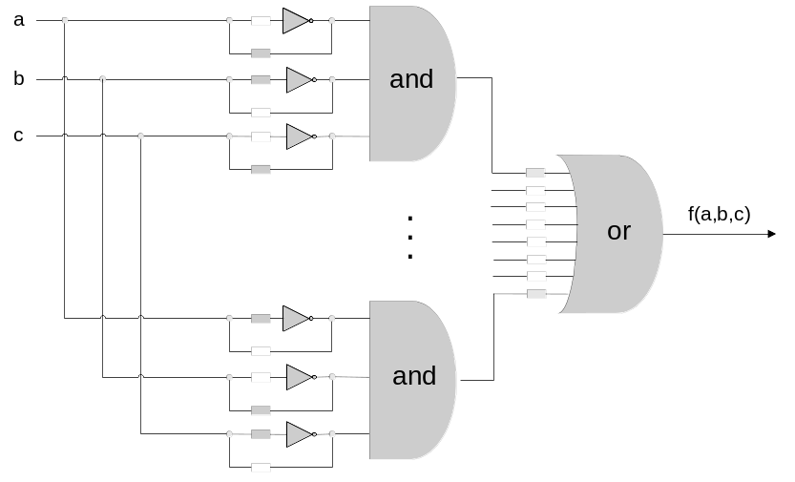
Perspective
Each Boolean function has a canonical representation
The canonical representation is expressed in terms of And, Not, Or
And, Not, Or can be expressed in terms of Nand alone
Ergo, every Boolean function can be realized by a standard PLD consisting of Nand gates only
Mass production
Universal building blocks,
unique topology
Gates, neurons, atoms, …

Slide 24
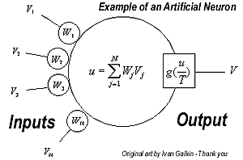
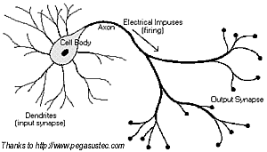
End note: universal building blocks, unique topology

